Slide 1

To-Do Project
By Mohamud Mussa

Slide 2
Introduction
First Class Degree in Computer Science.
Background in SQL.
Problem Solving.
Creativity is everything to me.
Web Design, Graphic Design, Documentary Making. YouTube.

Slide 3
Project Summary
To Create a full stack web application using the 3 tier architecture system.
The Application is a To-Do List which Allows users to Create, Read, Update, Delete their tasks and interact with the website.

Slide 4
How did I approach the project specification?
Understanding the project
Developing a Risk Assessment from that understanding
Breaking down the MVP
Initial design process – ERD - UML
Writing the logical approach to the project down.
Attempt to tackle the project

Slide 5
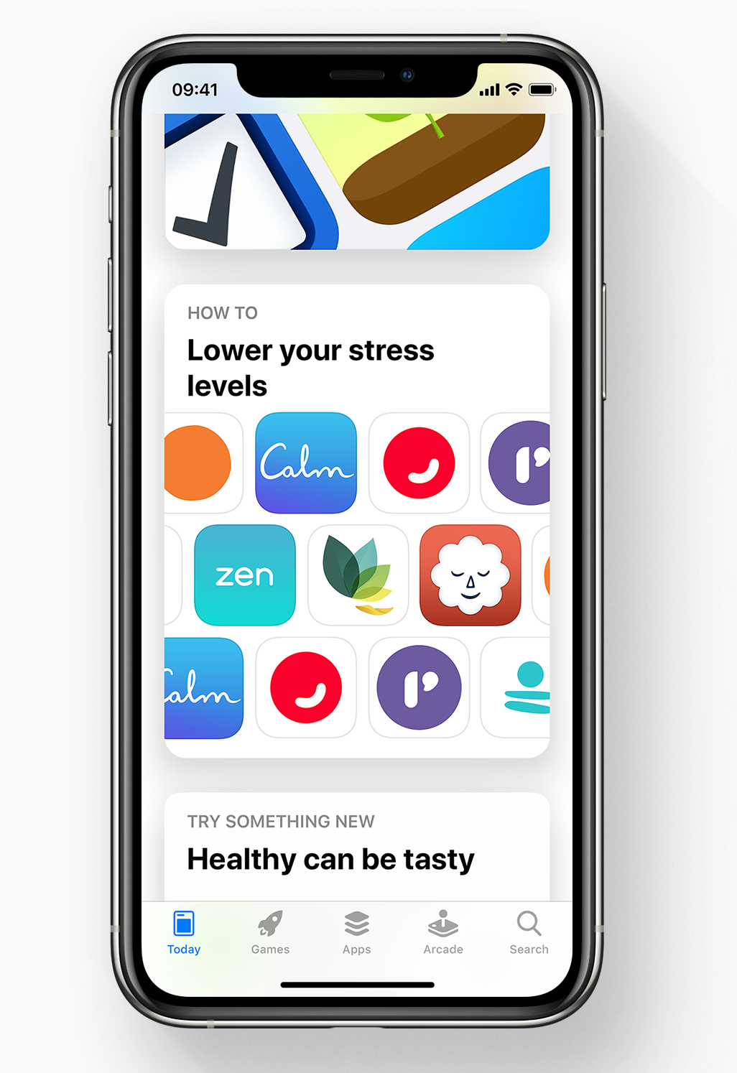
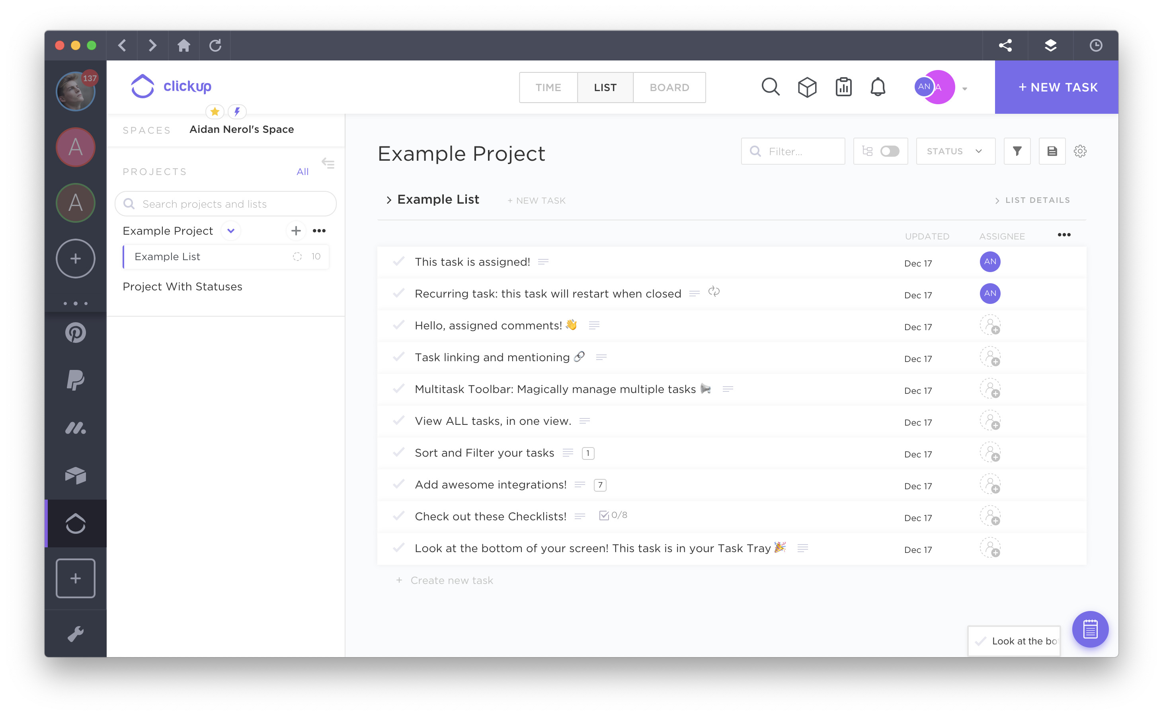
Personalising the project
Real world issue
Tackling existing issues
Avid user

Slide 6
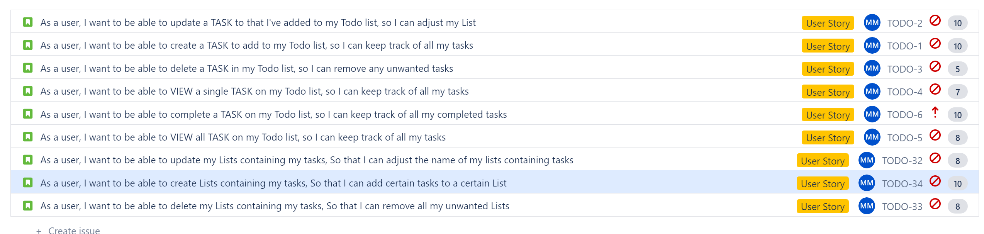
Understanding
Understanding the MVP specification and creating User stories and tasks based on them.

Slide 7
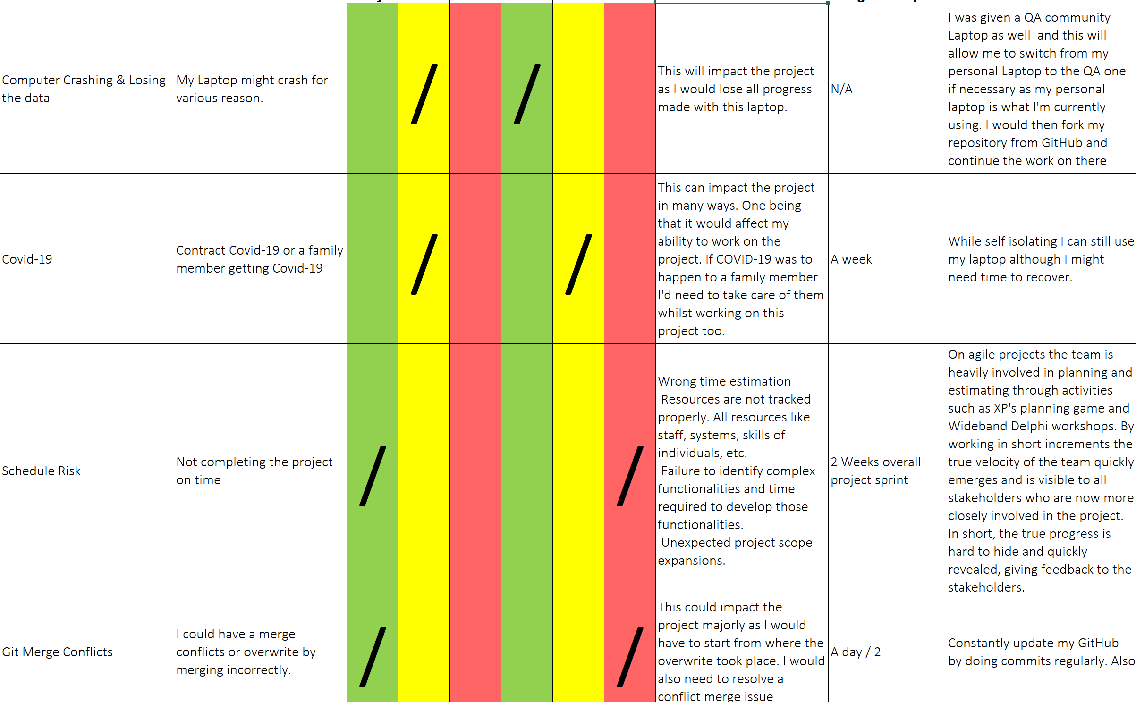
Risk Management
Creating a Risk Assessment based on that.
Looking at project with a new perspective based on previous project.
Time management using Jira Software to better plan my Sprints.

Slide 8
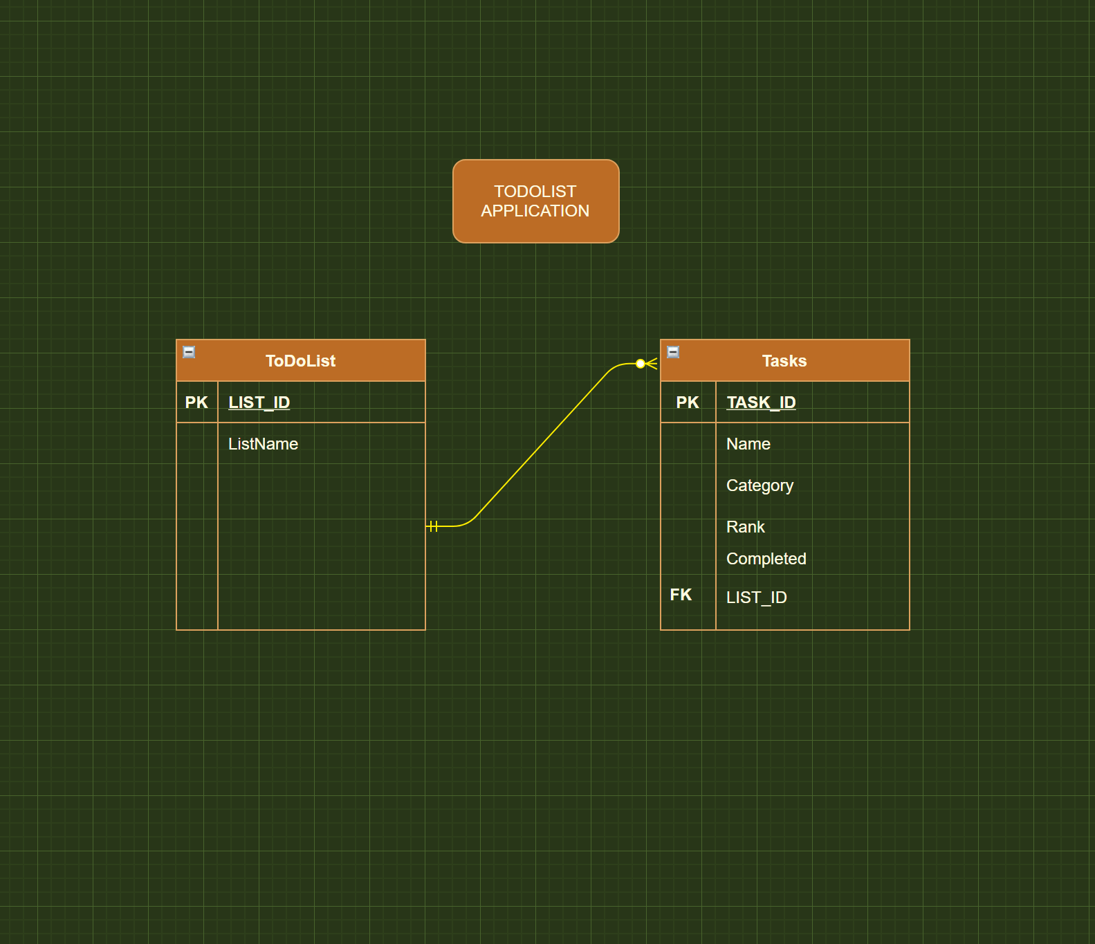
Design
Designed my ERD to better understand the structure of the database I wanted to create. Which would store users Tasks and their custom Lists containing tasks.

Slide 9
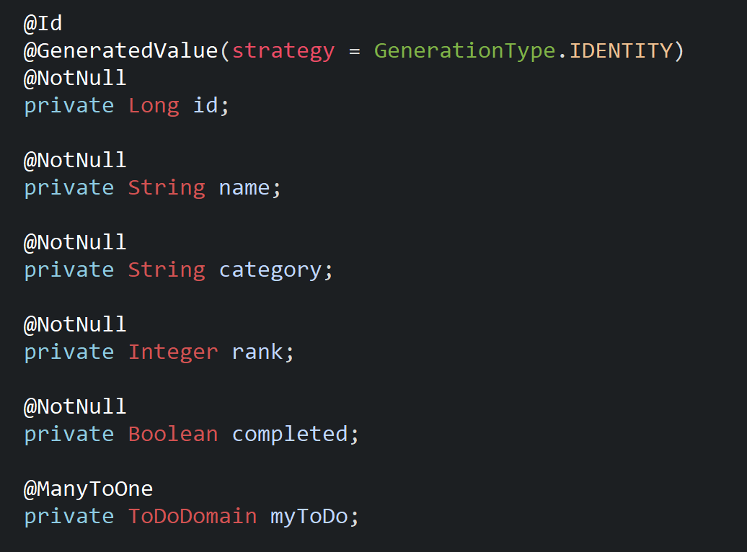
Application
This would later be used to code my Domain Class in order to set up my Many To One relationships in the application.

Slide 10
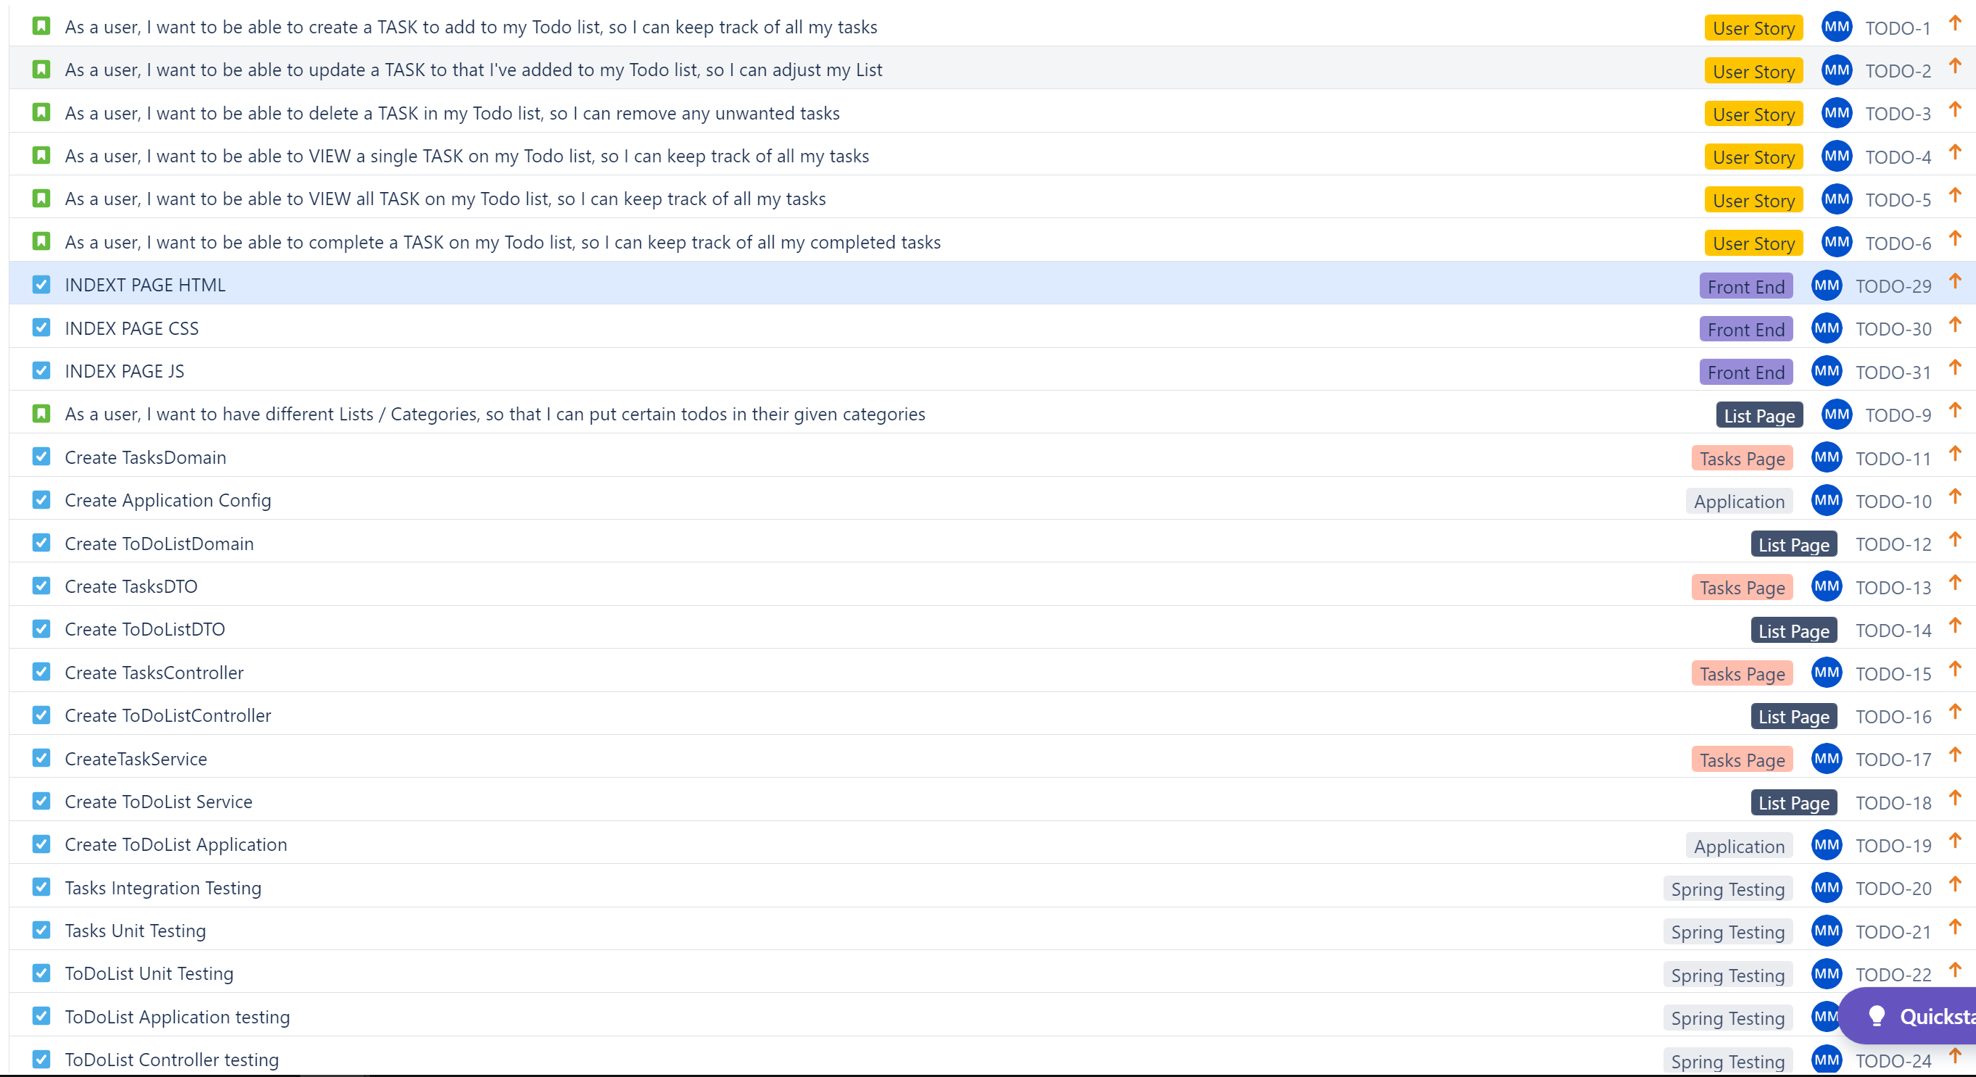
Sprint Plan

Slide 11




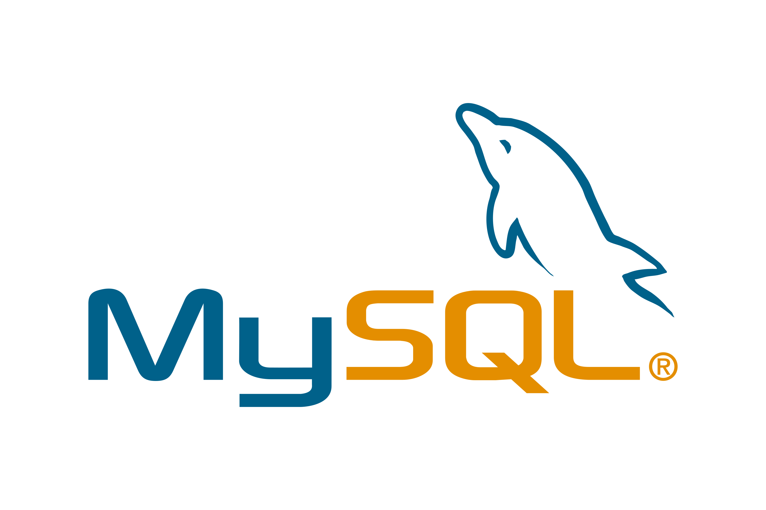




Technologies
The technologies I have learnt for this project;
Git – Version Control
Markdown – Used to create README
H2 is a relational database management system
Spring Boot – Used to code the backend of the To-do Project (Java)
HTML/CSS/JAVASCRIPT – was used to create the front end of the application.
Jira – Used to create the two sprints and keep track of user stories and tasks
Maven – Used to download Java libraries and Maven plugins & store them in a local cache
Testing (Mockito / Junit / Selenium )
Postman – API development view. Alongside SWAGGER
SonarQube – to analyse code against best practice standards and then improve the code.

Slide 12
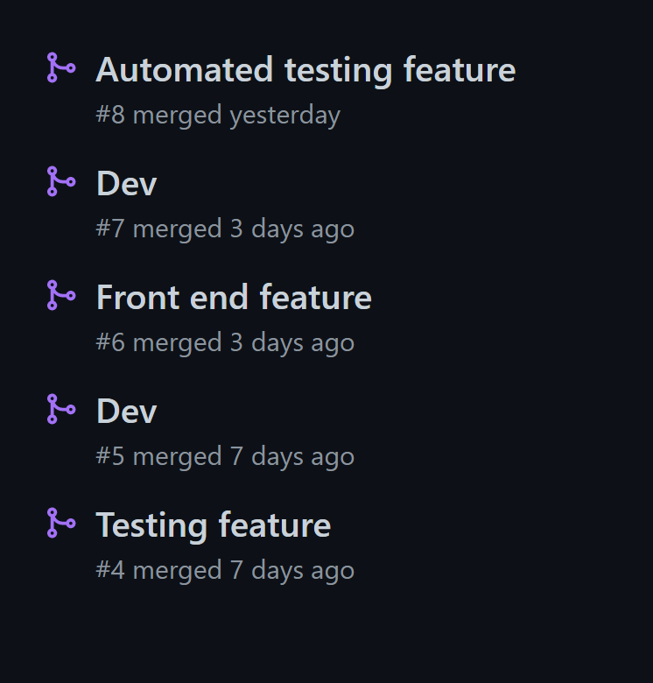
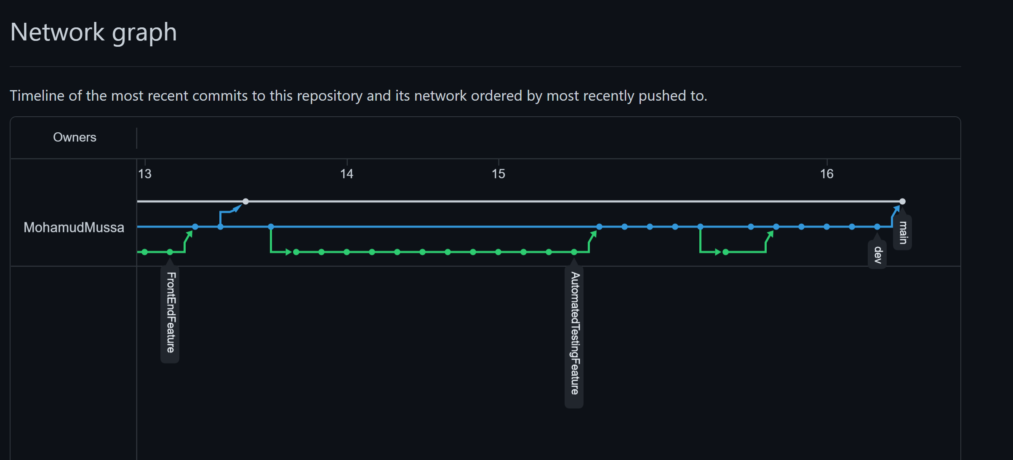
Continuous Integration
GitHub was used for Version Control and continuous integration. This was done by using feature / dev concept model. Pull Request and Merging into Master
Splitting branches by Epics

Slide 13
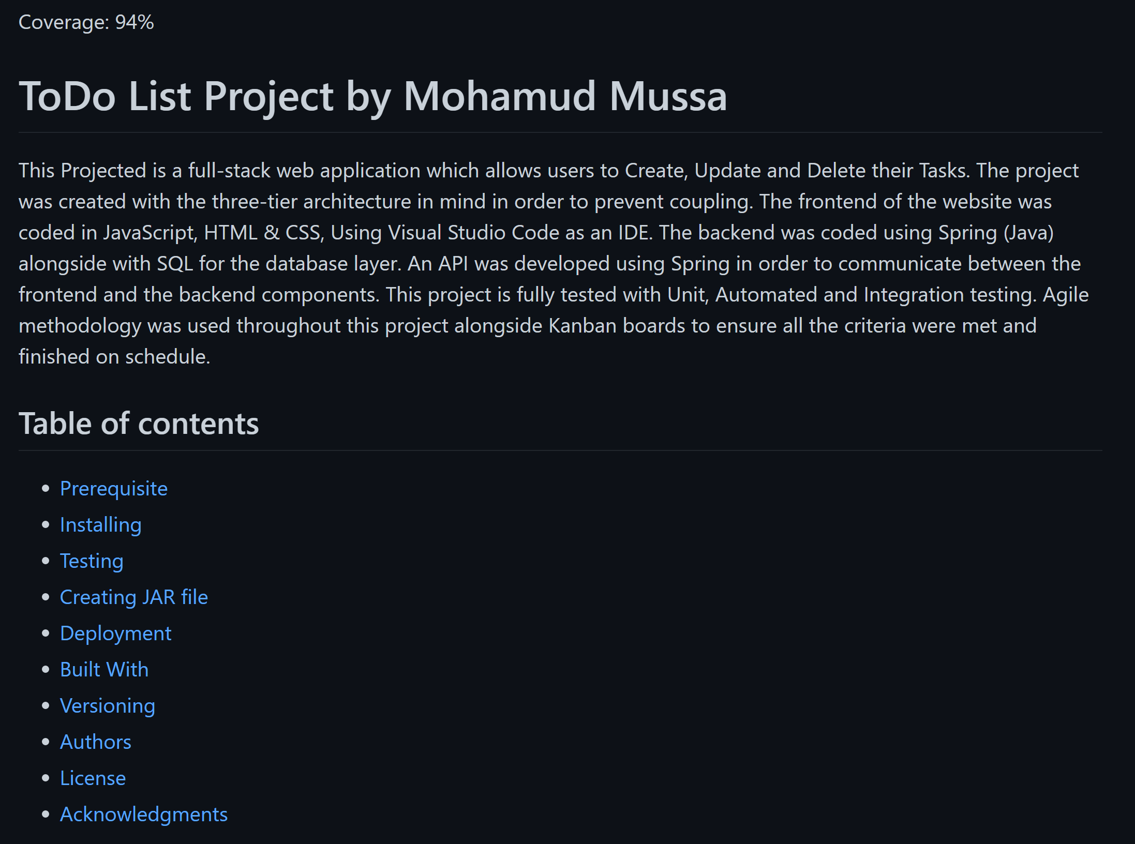
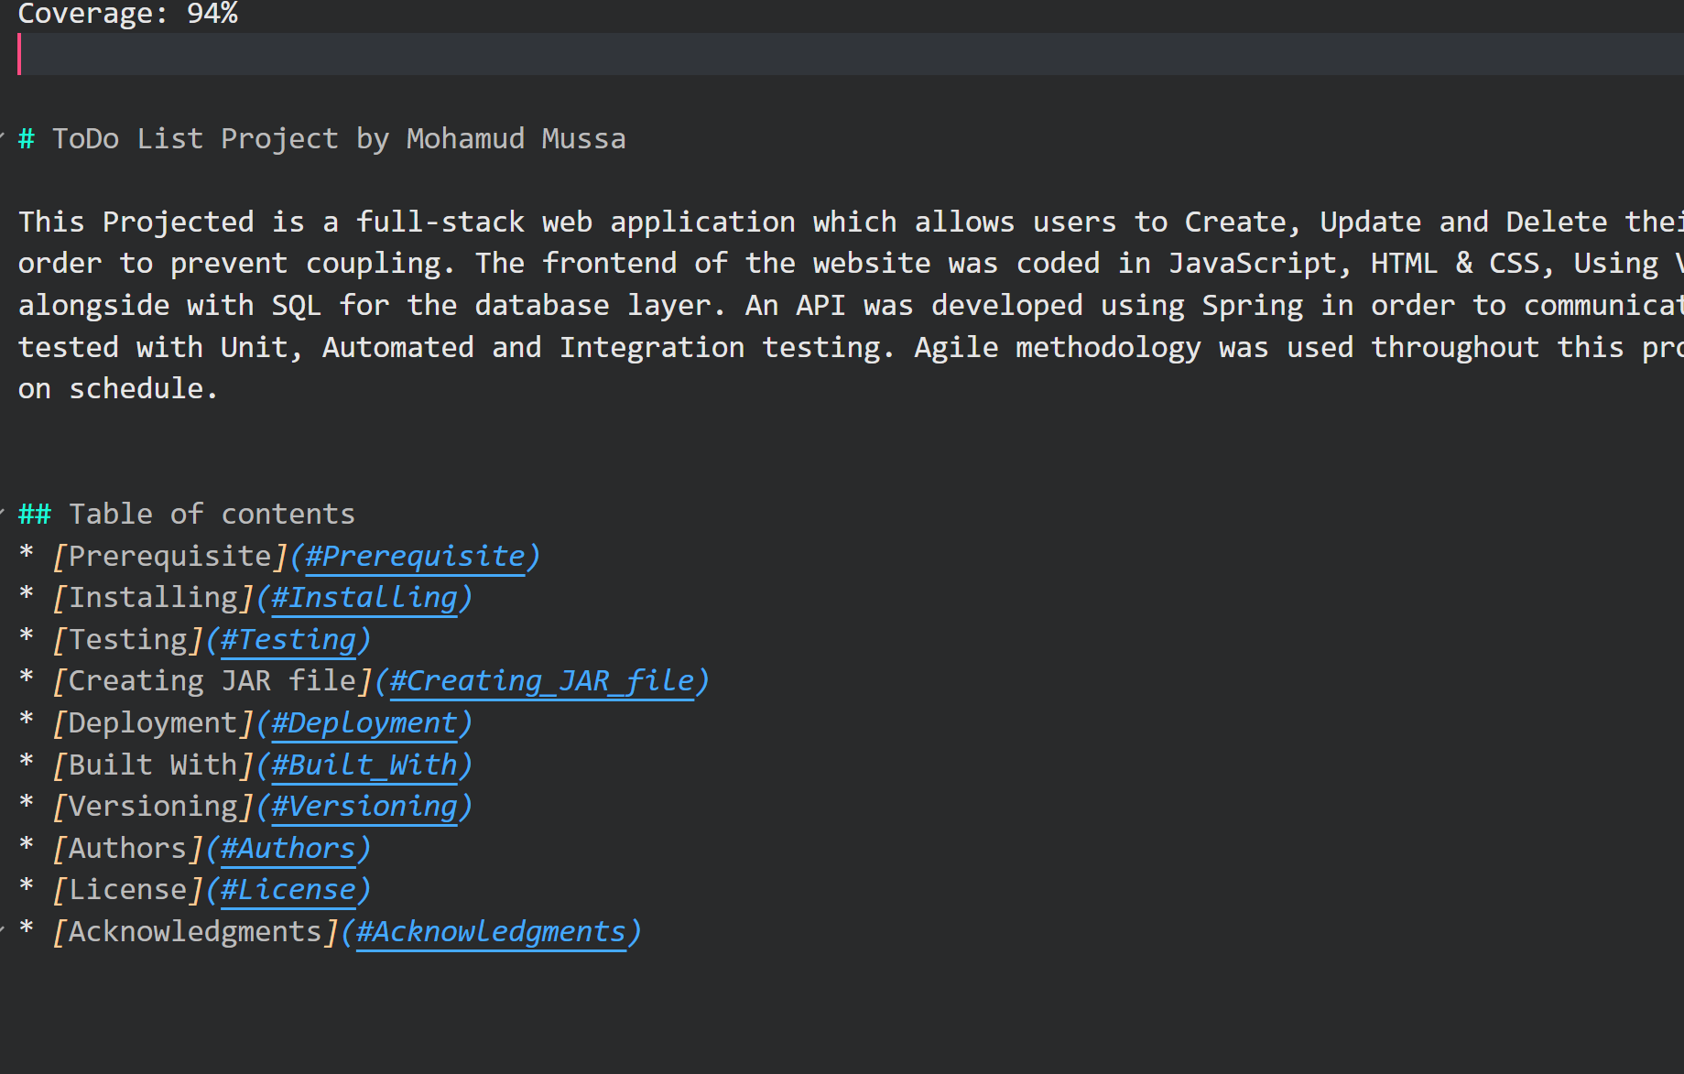
Markdown README

Slide 14
Database

Slide 15
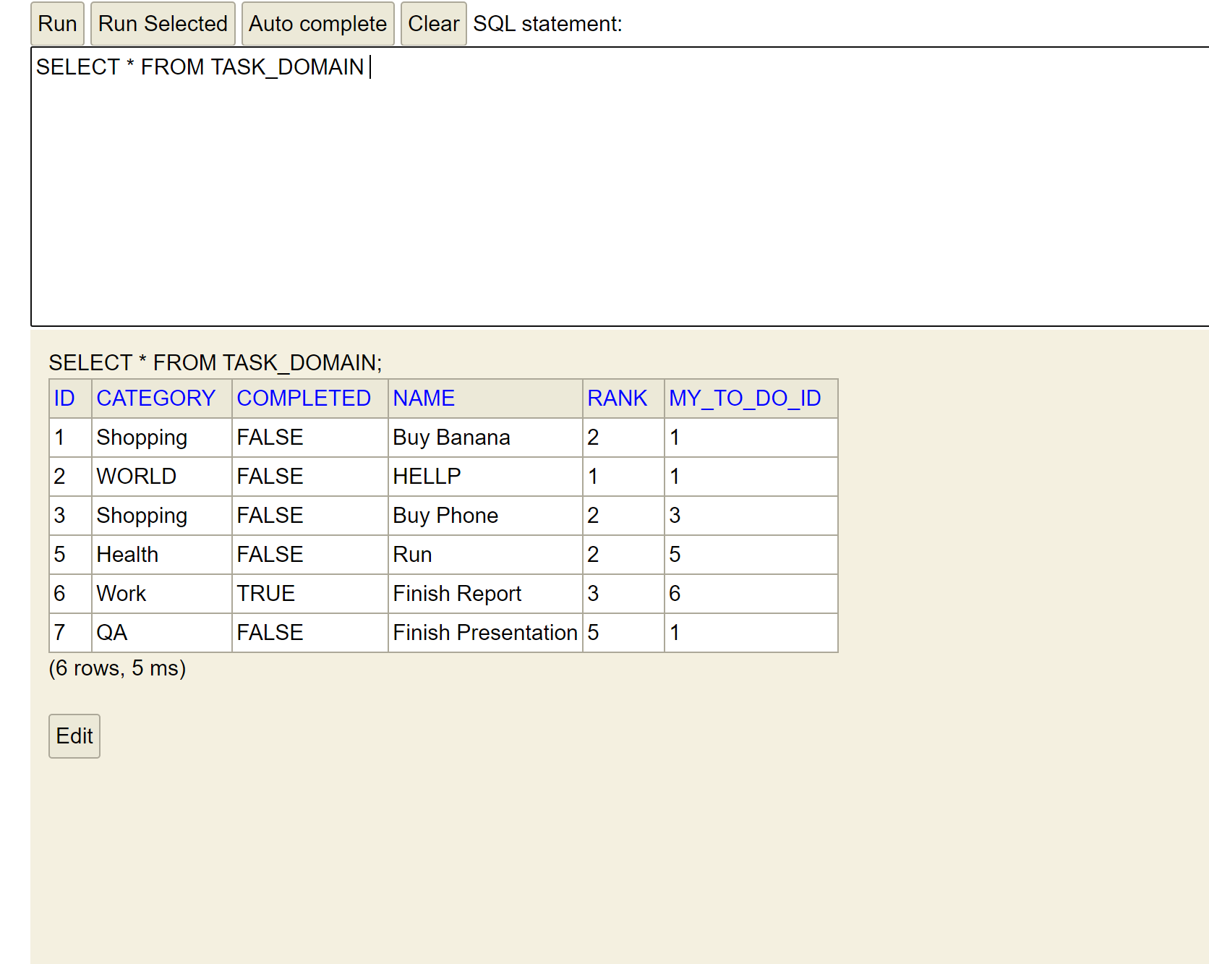
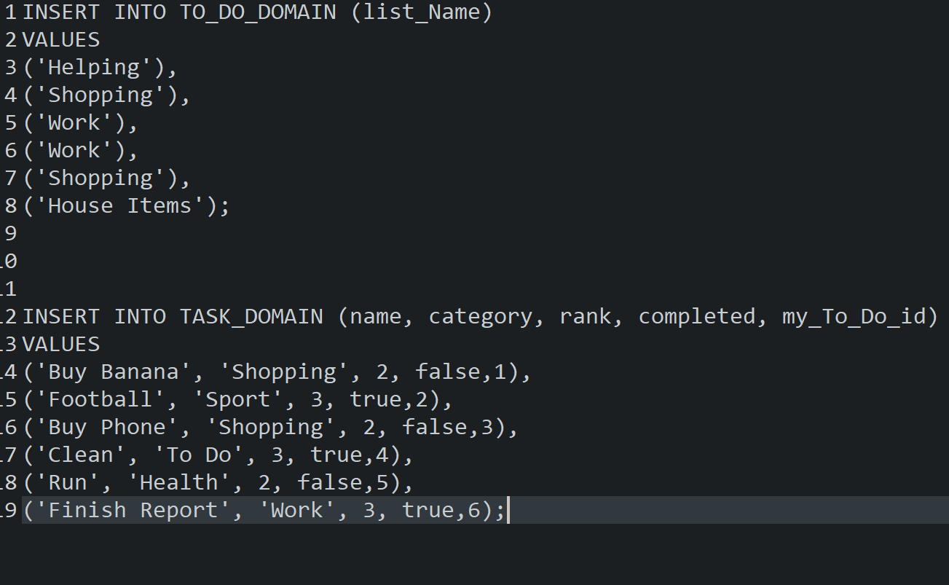
H2 Database
Relational database management system which was embedded into the To Do application.

Slide 16
Back-end

Slide 17
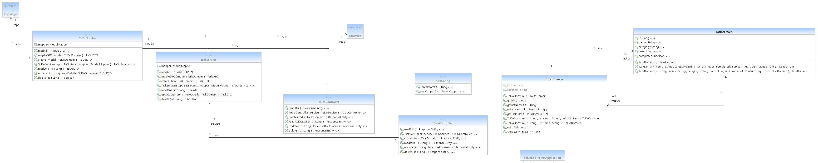
Spring Boot
API transfers the data between frontend and backend
Controller - generates the http request
Controller has a services - which stores the main logic of the application.
Services calls on the repo which extracts from the database.
Repo - DAO connection to database.

Slide 18
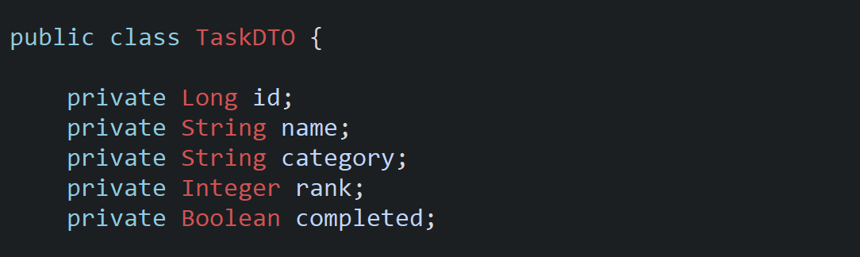
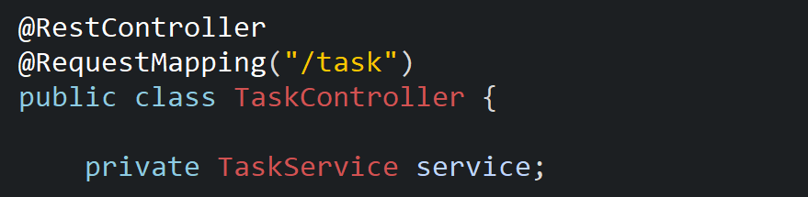
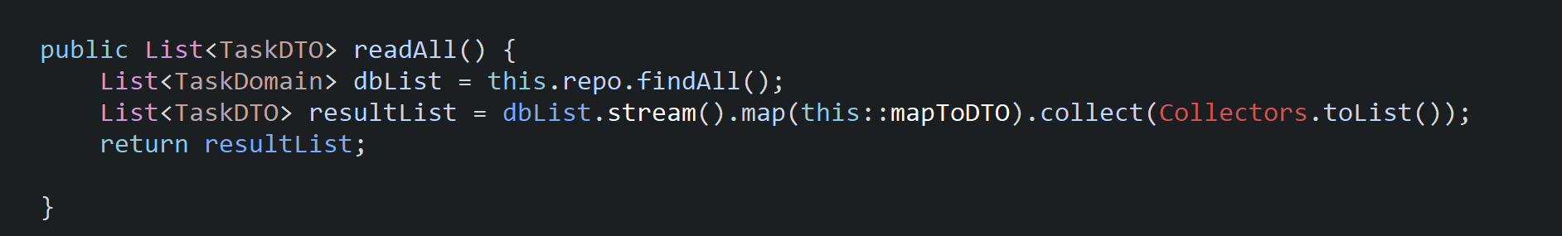
Domain
DTO
CONTROLLER
SERVICE

Slide 19
Front-end

Slide 20
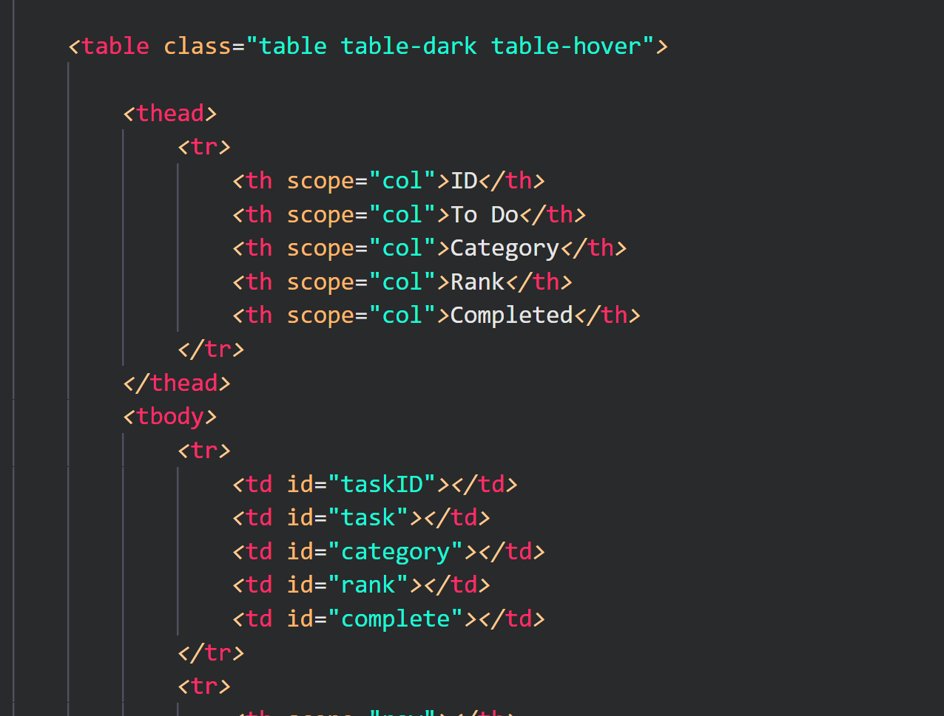
HTML
Use of tables to organise the data received from the API.
Simple
Minimalistic
User-friendly.

Slide 21
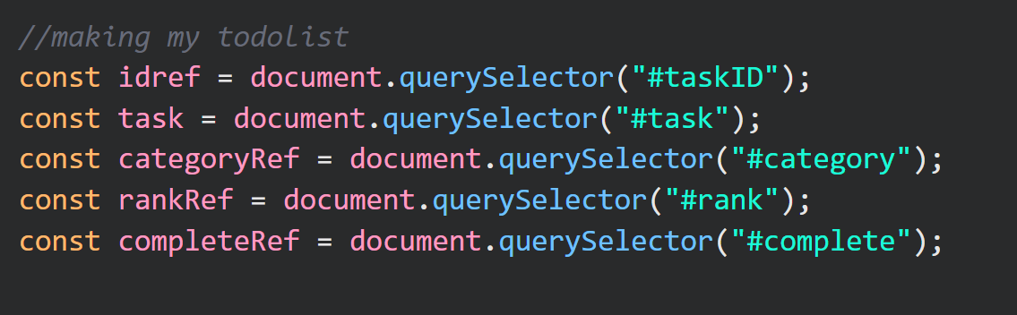
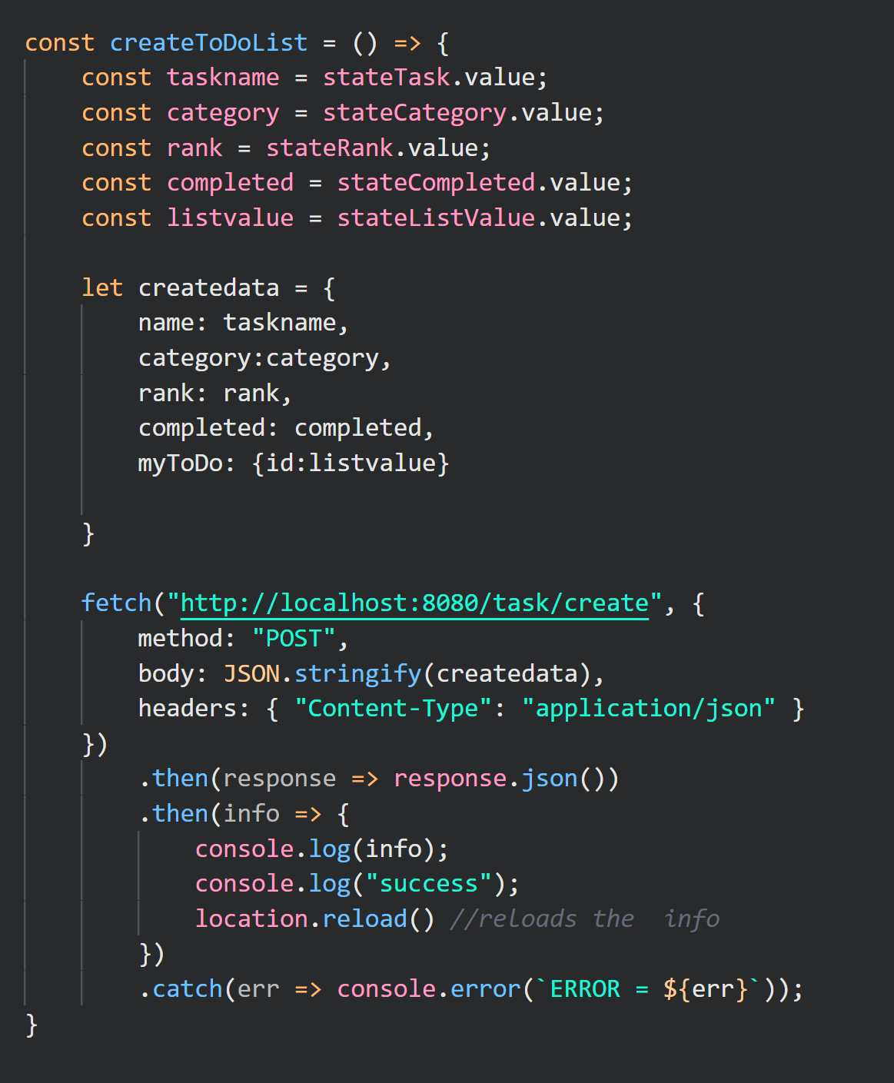
JAVASCRIPT
API request
Creating A Task
Using DOM through HTML
Displaying the data consistently
Refresh to update website seamlessly

Slide 22
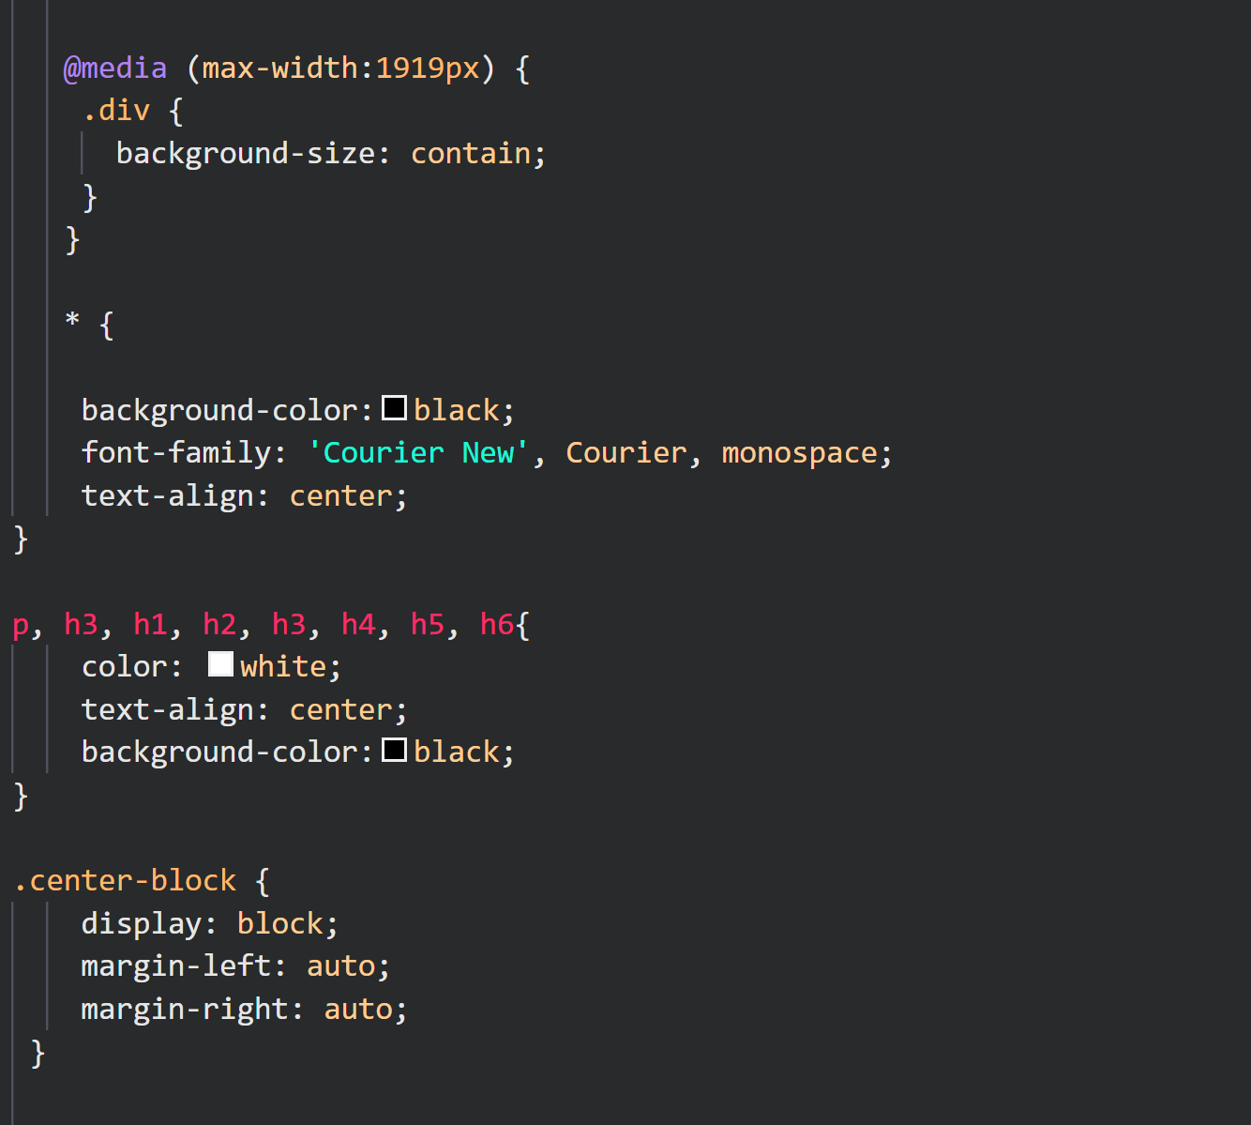
CSS
Understanding design}
Minimalistic Design approach.

Slide 23
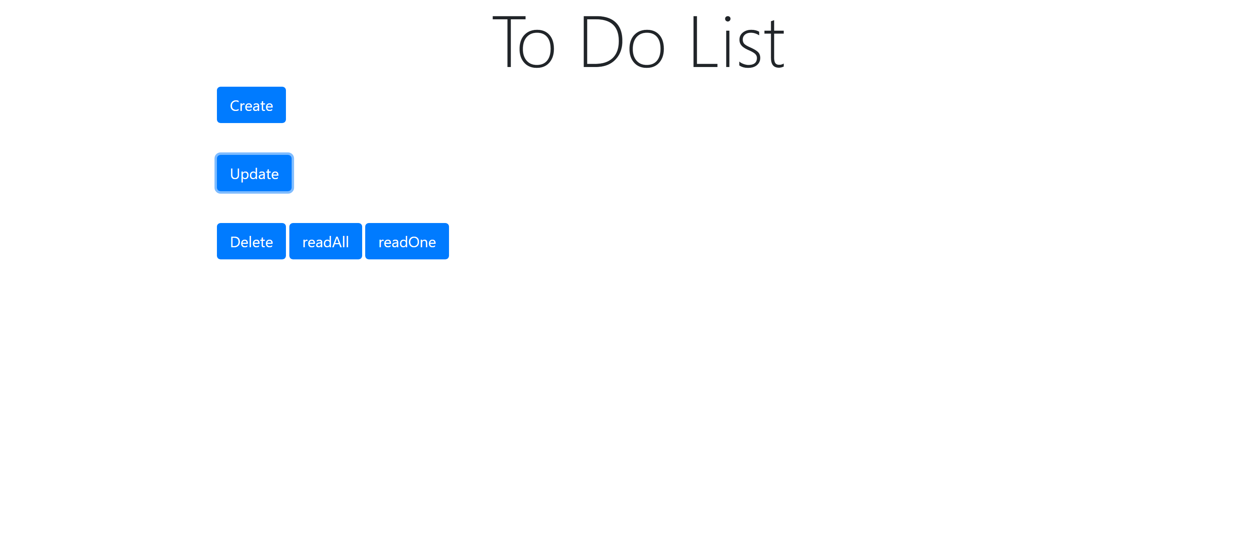
Initial Website

Slide 24
Demonstration

Slide 25
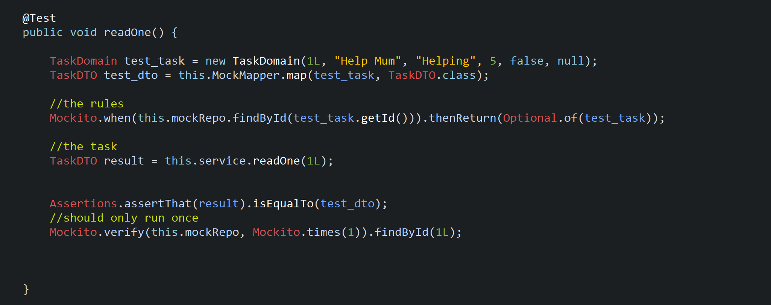
Testing
Unit Testing
was used to check and test individual Units of code in order to validate whether code performs as expected
}
}
}

Slide 26
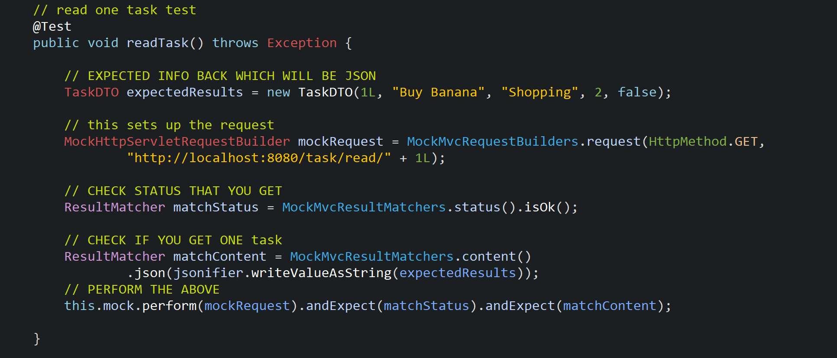
Testing
Integration Testing

Slide 27
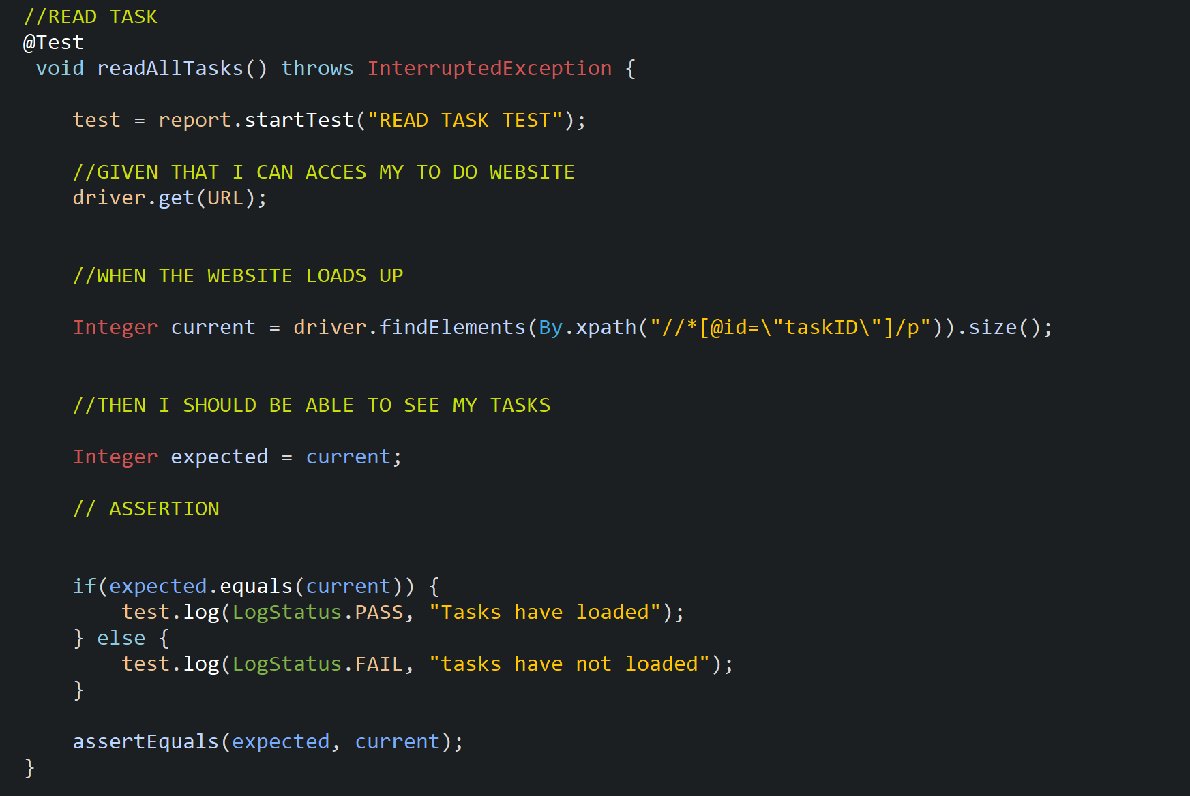
Testing
Automated Testing
Was used to translate User Stories into automated tests. This would ensure that all user acceptance stories were working as per design.
}
}
}

Slide 28
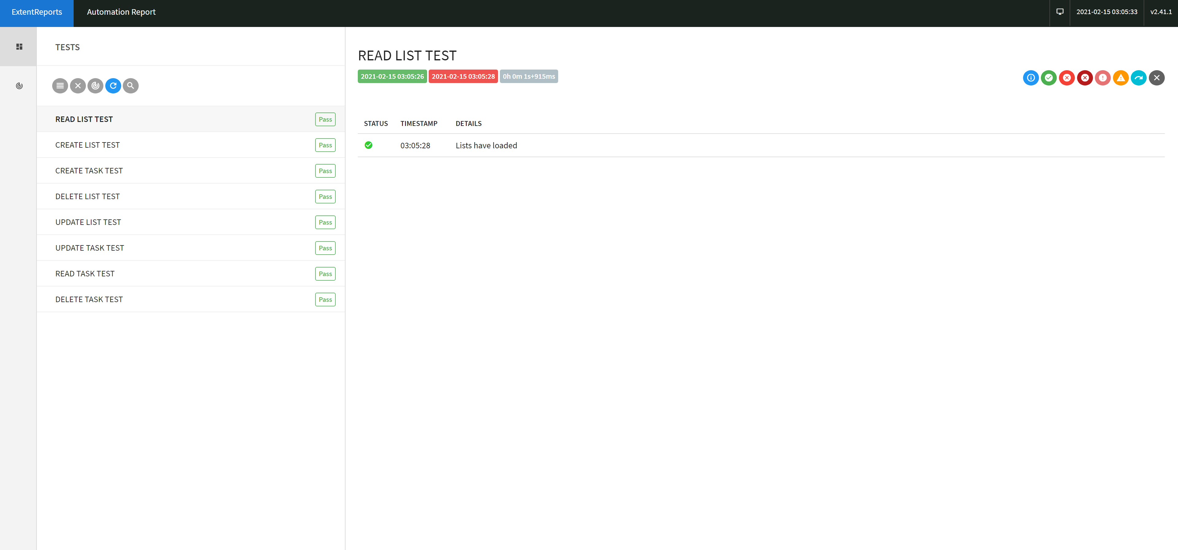

Slide 29
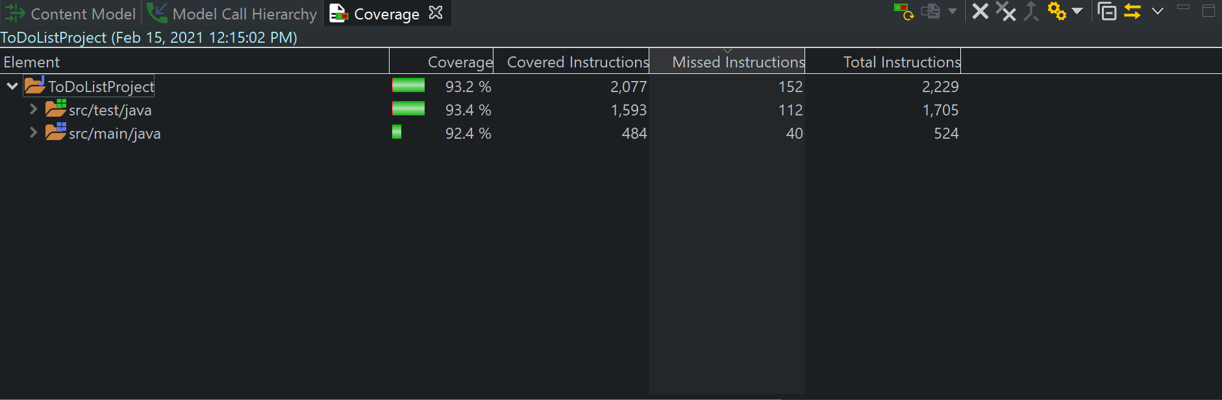
Testing
Project Coverage.

Slide 30
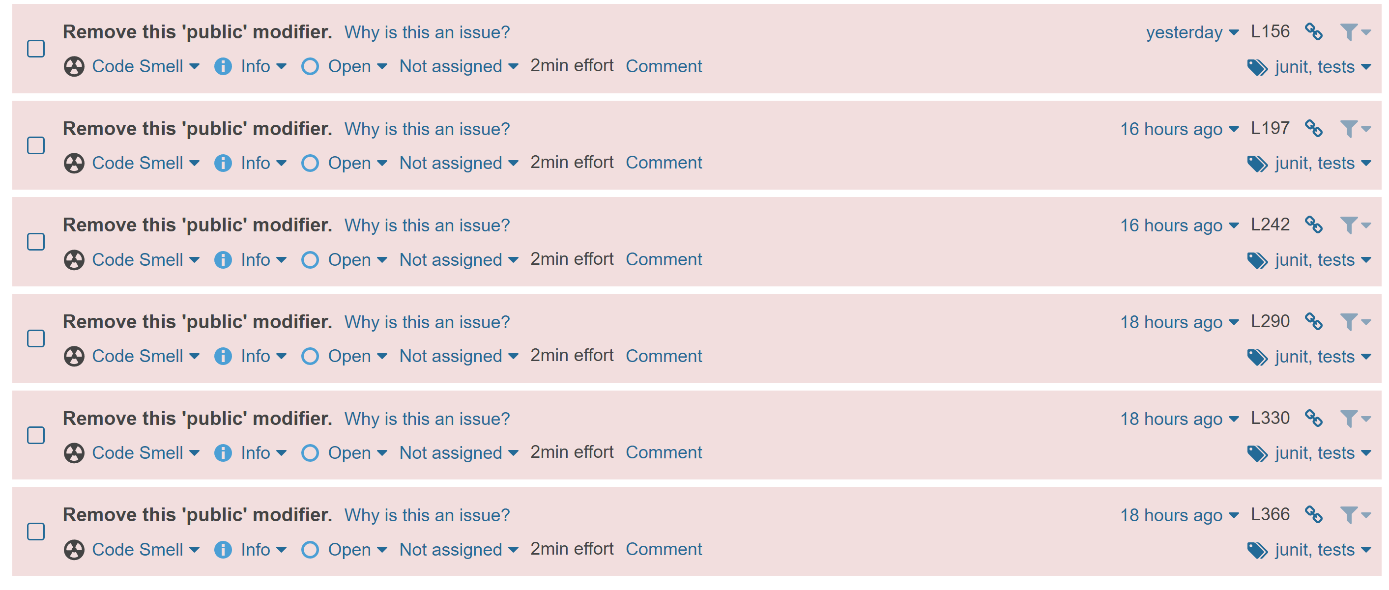
Improving the project
Sonar Cube was used to analyze the project code and test it against industry's standard. This was then used to improve the code

Slide 31
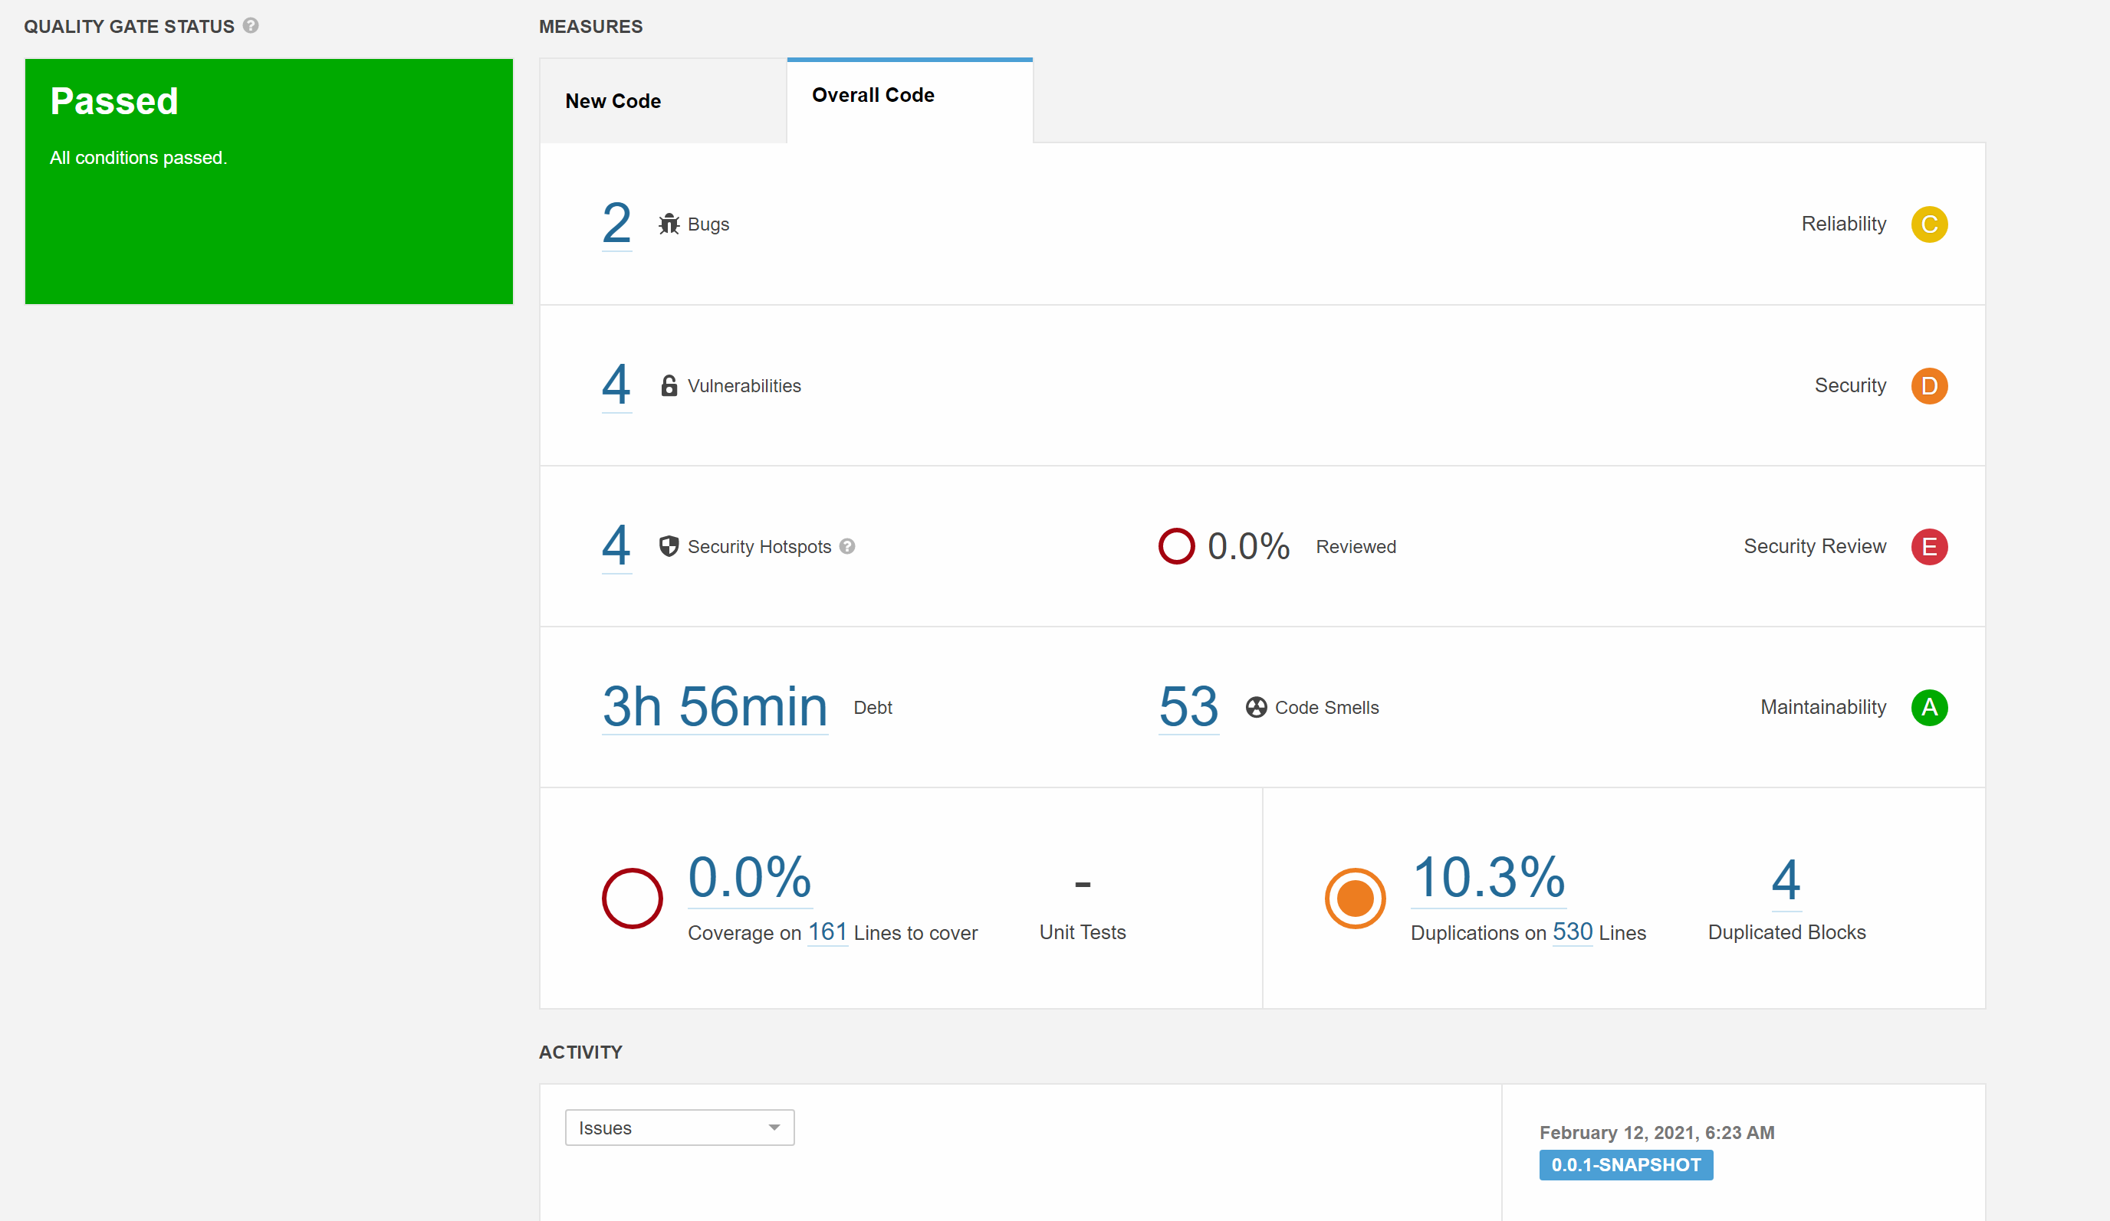
Improving the project
Test-driven development to further improve the application

Slide 32
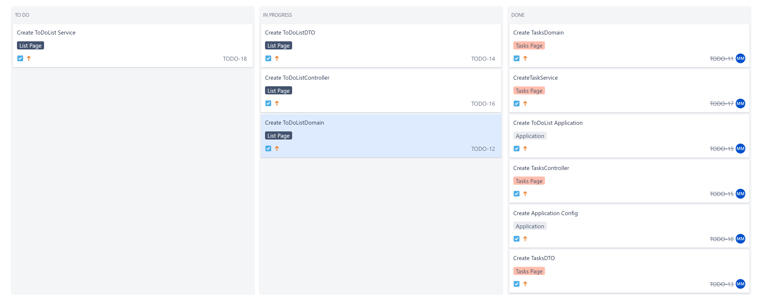
Sprint Review 1

Slide 33
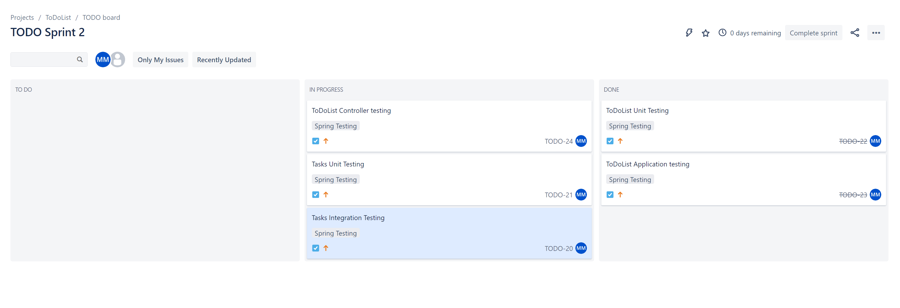
Sprint Review 2

Slide 34
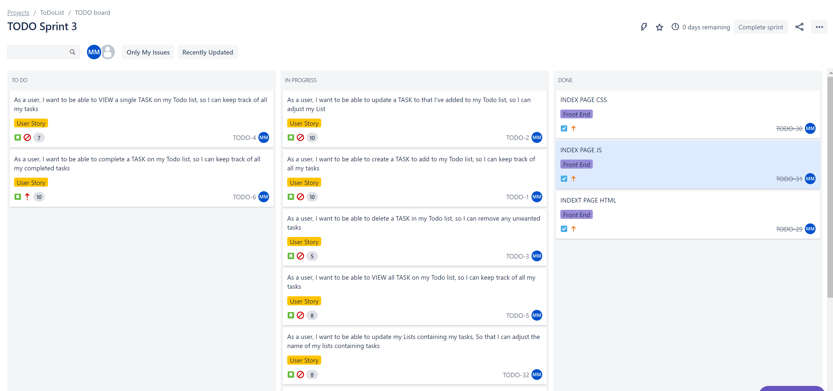
Sprint Review 3

Slide 35
Sprint retrospective
What went right?
Testing and Time Management.
Completed all CRUD functionality for the Full Stack Application.
Built a fully functioning frontend with a focus on design.
Completed Testing for full application & Improved via SonarQube.
Met the MVP and then focused on improving.
What went wrong?
Wanted to include more features on the website.
What would we change?
Include a light mode on the website.
Improve print ability

Slide 36
Conclusion
Project MVP was met successfully.
Able to create a full stack application with functioning tests.
Able to solve issues quickly and efficiently to ensure the deadline is met.
Leant a lot and will continue to add features and testing in my spare time to improve my understanding of all the technologies I learnt.
Built an understanding on how to take on a Project from ground up.
Built an understanding of best practices throughout the project.

Slide 37
THANK YOU Any Questions?

